Slide 1
Power BI in Microsoft Teams
Module 5
Notes:
Workshop Version: 1.4

Slide 2

Module overview
This module covers the following topics:
 | 1 | Overview of Power BI in Microsoft Teams
 | 2 | Get data from Dataverse for Teams
 | 3 | Transforming and modelling data
 | 4 | Building reports
 | 5 | Optional lab: Use table data for Power BI Analytics

Slide 3






Overview of Power BI and Microsoft Teams
Power BI enables users to create reports based on data from Dataverse for Teams tables and other data sources
Access to the data is determined by Dataverse for Teams security model
Has additional licensing requirements
Microsoft Confidential
Notes:
Power BI Pro licenses are required to share and consume shared Power BI reports OR reports and datasets must be hosted in Power BI Premium capacity

Slide 4


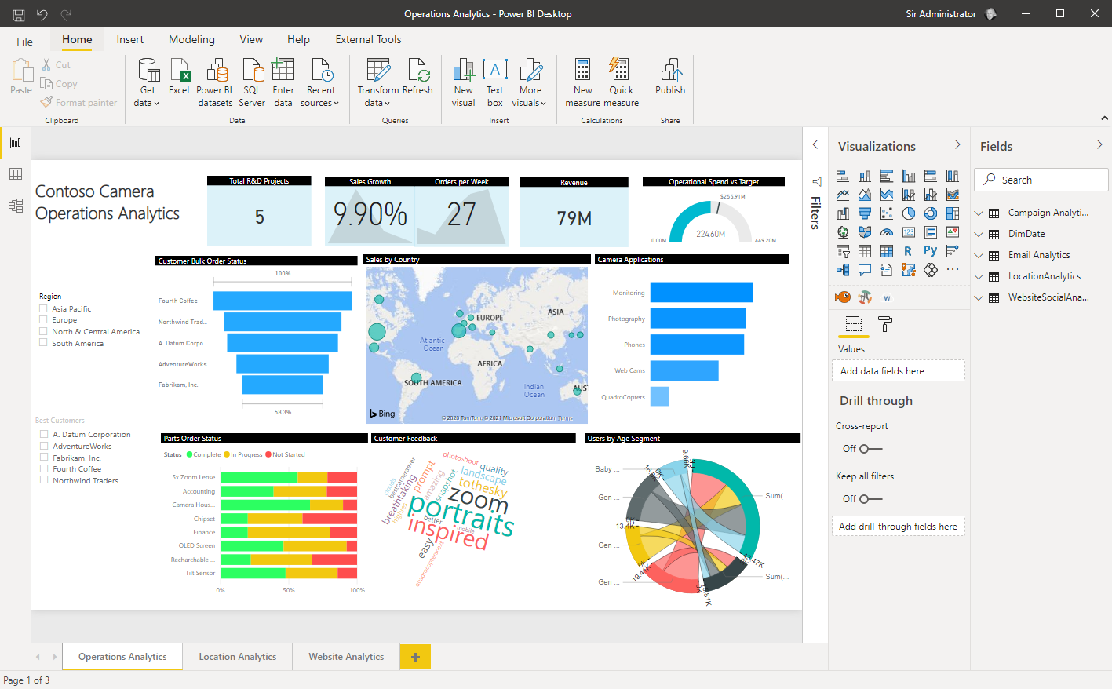
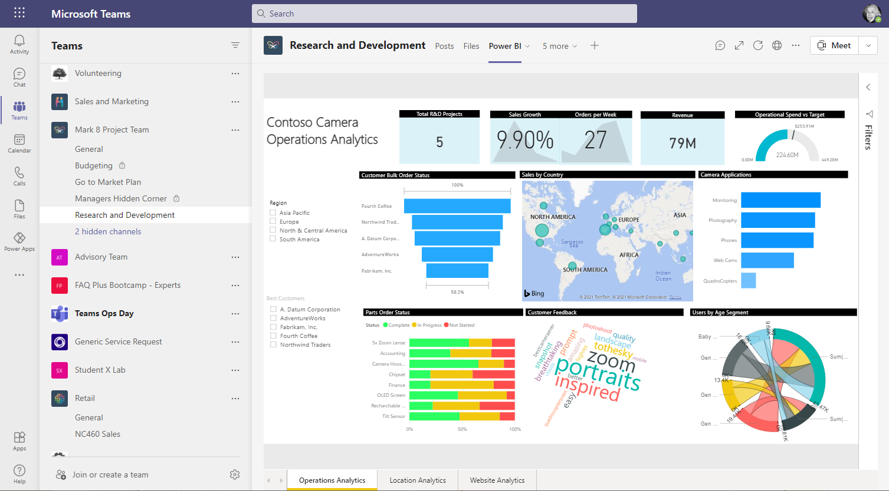
Power BI Desktop and Power BI Service
Power BI Desktop
Power BI Service
Publish
Authoring tool – connect to data, transform, model and visualize
Publish reports and dashboards, apply permissions and enable data refresh
Microsoft Confidential
Notes:
Power BI Desktop is a visual data exploration and interactive reporting tool, providing a free-form canvas for drag and drop exploration of your data, an extensive library of interactive visualizations, and an authoring experience for ease of report creation for the Power BI service.
To get started, you must download the free desktop application from Microsoft Store optimized for use with the Power BI Service (monthly updates)
Power BI Service (powerbi.com) cloud service, part of Microsoft 365, used to host and manage datasets, reports, visualizations and provides variety of additional features.

Slide 5





Power BI report creation stages
Data acquisition
Transform data
Data Modeling
Report Creation
Publish and secure
Get data from Dataverse tables and more
Prepare data using Power Query
Define relationships and calculations
Evaluate calculations and build visuals
Publish to Power BI Service
Microsoft Confidential

Slide 6


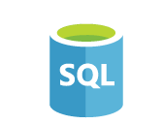













Data acquisition
Connect to 100+ data sources, both on-premises and cloud
Use Dataverse connector to get data from Dataverse for Teams tables
Combine data from multiple data sources to build more complex models
Microsoft Confidential

Slide 7
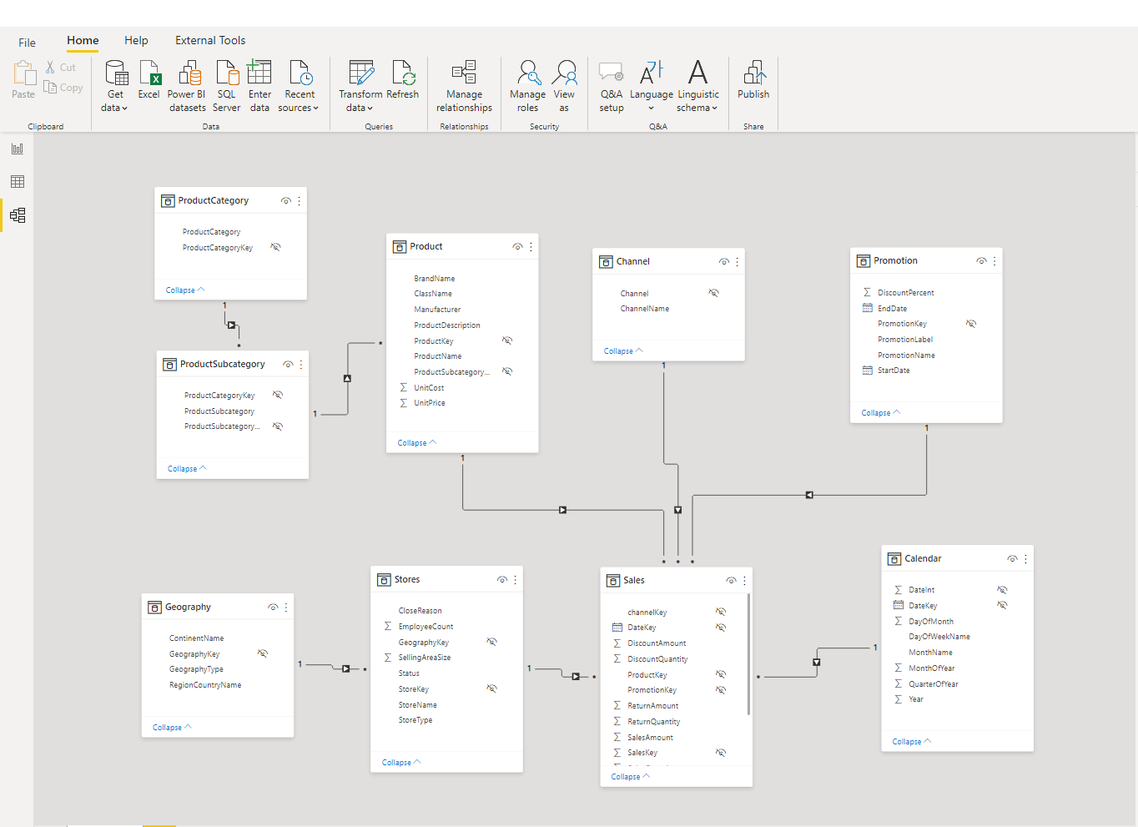
Transforming and modelling data
Shape, transform, and clean data for analysis using Power Query or GUI
Define entity relationships in the model
Format and categorize data columns
Create calculations with DAX formulas
Microsoft Confidential
Notes:
DAX formulas: Dynamic Expression Language to query data model
Power Query: used for data transformations (same UI as in interface)

Slide 8
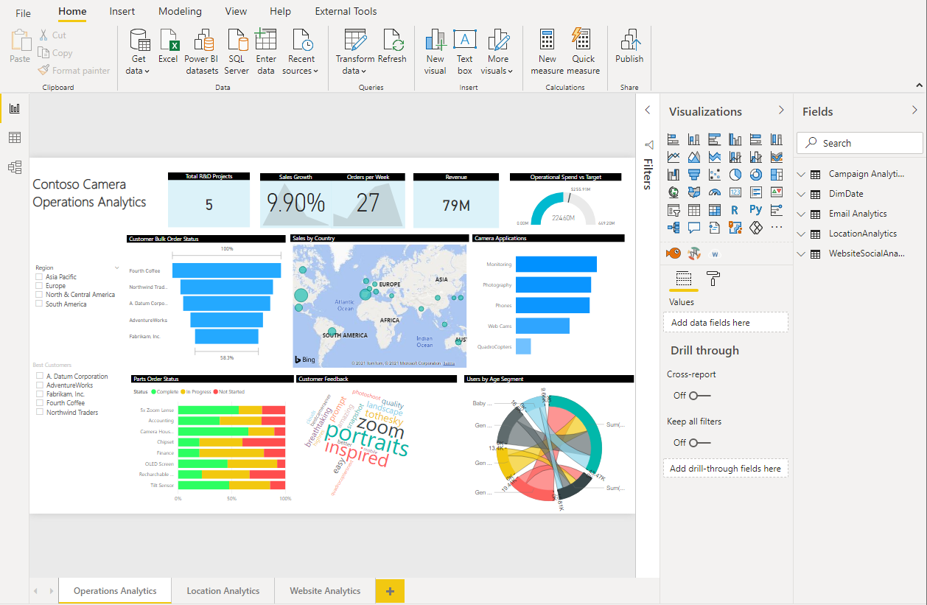
Building reports
Author reports using 150+ visuals via a drag-and-drop canvas
Improve interactivity with bookmarks and custom navigation
Define roles for row-level security
Microsoft Confidential

Slide 9
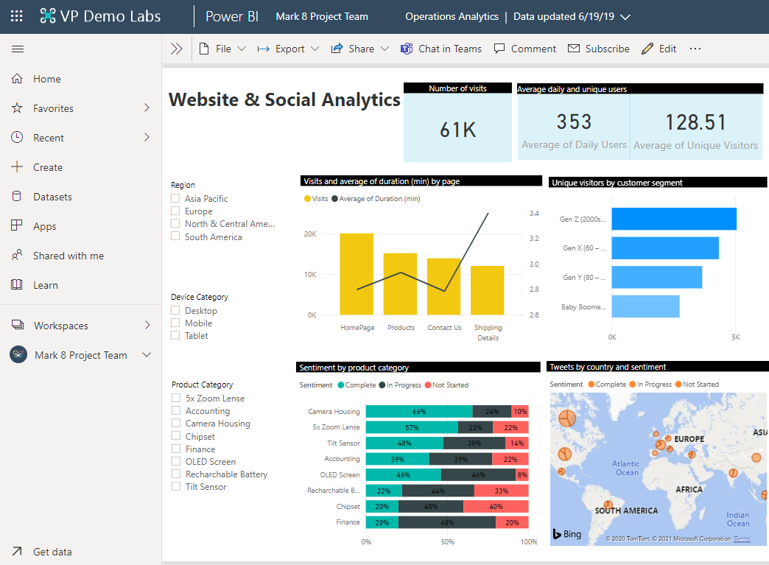
Publish to Power BI Service
Publish reports to make them available for colleagues
Set permissions and data refresh
Manage your analytics content with admin and governance tools
Embed content into Microsoft Teams
Microsoft Confidential

Slide 10

Lab 5 (optional): Use table data for Power BI analytics
Objectives
Get data from Dataverse for Teams and prepare it for analytics
Explore basic Power BI capabilities
Build and publish Power BI report
Never upload your organization data to the lab tenant.
Notes:
If customer asks about CQD + power BI please refer them to Media Quality Assessment offering.
( mention in Delivery Guide)
##########

Slide 11
Appendix

Slide 12
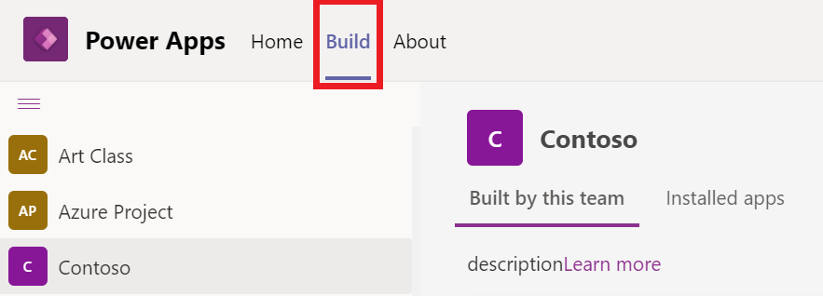
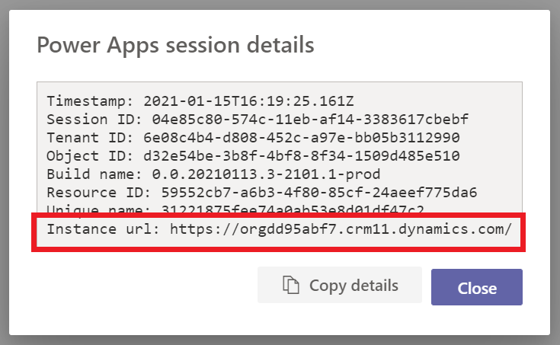
Get the URL of your Dataverse for Team environment
Using Power Apps app, get to the Session details in About tab
Retrieve the URL of your Dataverse for Teams environment to connect to from the Power BI Desktop
Microsoft Confidential
Notes:
This feature is enabled only for the Dataverse for Teams environments created with the General Availability release. Dataverse for Teams environments created during the Public Preview release will be enabled later.
View Dataverse for Teams table data in Power BI Desktop (Preview) - Power Apps | Microsoft Docs
You can use Power BI Desktop to view data from tables in Dataverse for Teams. This enables you to create sophisticated reports to analyze data from your Dataverse for Teams tables. This is possible using a new connector that can use direct query mode for real-time data while enforcing the Dataverse for Teams security model when accessing data. Additionally, the connector automatically maps relationships.
Get the URL
Start Teams, and sign in.
In the left pane, select Power Apps, and then select the Build tab.
Select the team in the left pane that contains the data you want to view in Power BI.
Select the About tab, and then select Session Details to display the session details information. Copy the Instance url value to notepad. This is the environment URL of your Dataverse for Team environment. For example: https://org72b45a75.crm11.dynamics.com

Slide 13
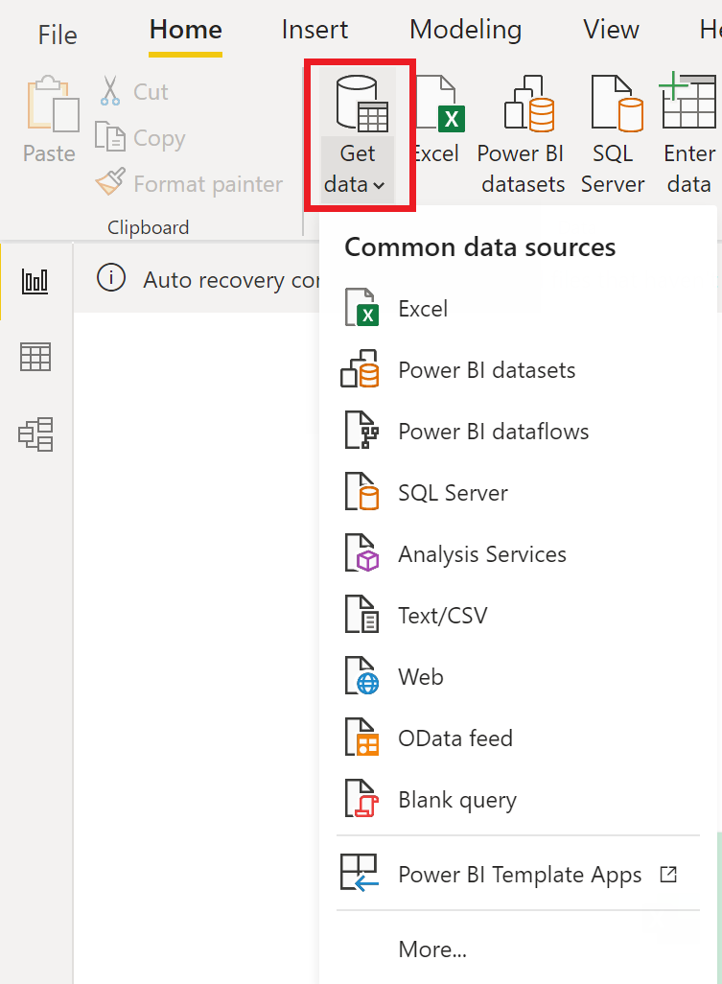
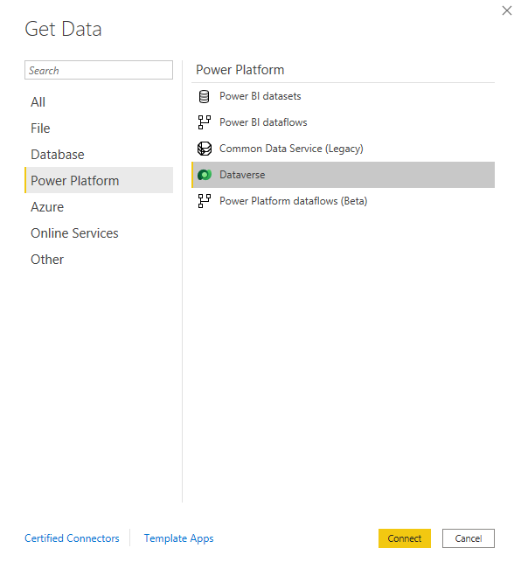
Connect to Power BI Desktop
Connect to Dataverse data from Power Bi Desktop
Microsoft Confidential
Notes:
Start working in Power BI Desktop
1. Open Power BI desktop
2. Get Data
3. Choose Dataverse. On the Get Data page, select Power Platform > Dataverse. Select Connect.
4. Use the url from above. specify the environment URL that you copied earlier. Make sure you remove https:// and the trailing / from the URL. So, in this case you will add orga0e34f66.crm.dynamics.com.
5. Sign in within Power BI using demo credential
6. Identify the tables you require
7. Close and Load
8. Establish the relationships between tables
9. Start building visuals

Slide 14
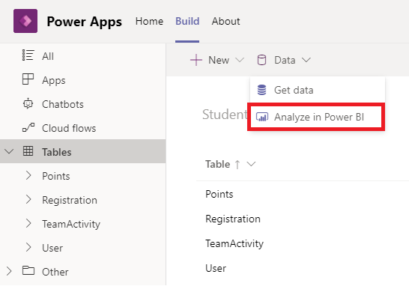
Analyze in Power BI
You can use Analyze in Power BI option to quickly download data connection (*.PBIDS file)
JSON file with connection info, that can be edited
Can be opened in Power BI Desktop to quickly create a data connection
Microsoft Confidential
Notes:
PBIDS - Data sources in Power BI Desktop - Power BI | Microsoft Docs

Slide 15
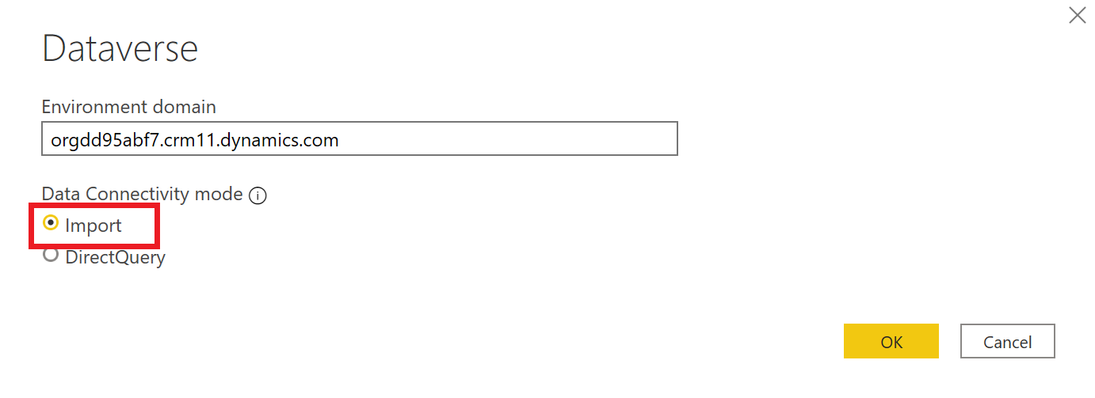
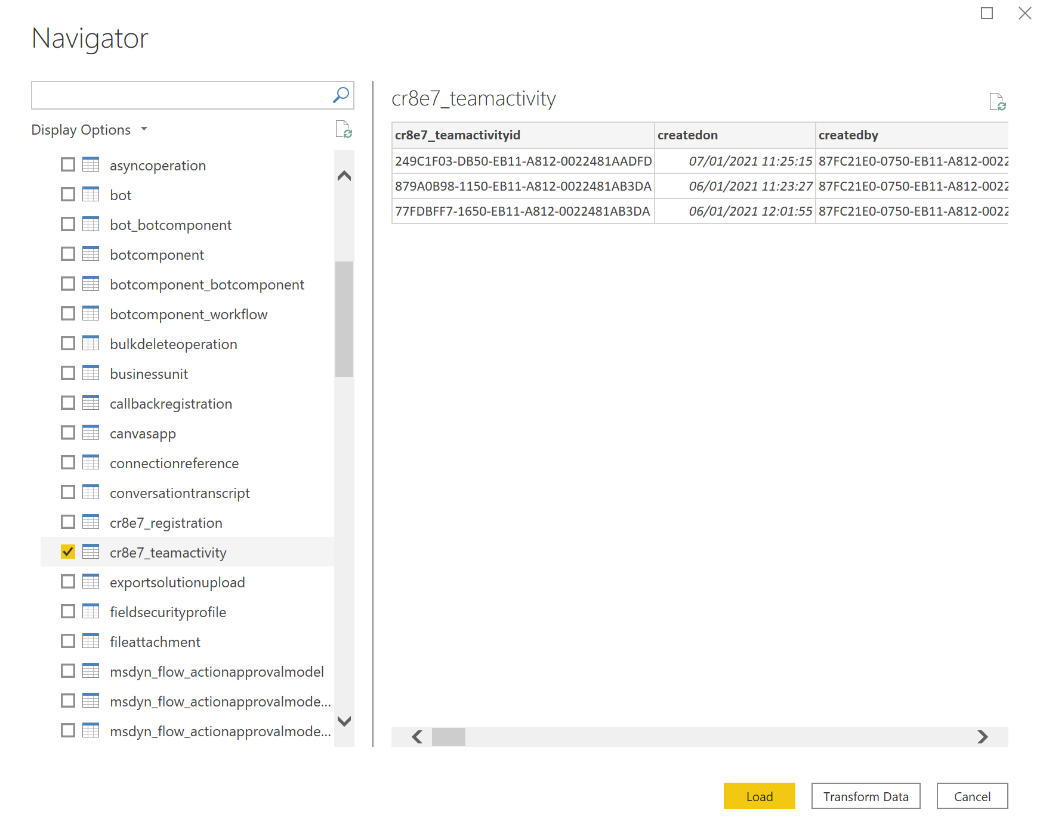
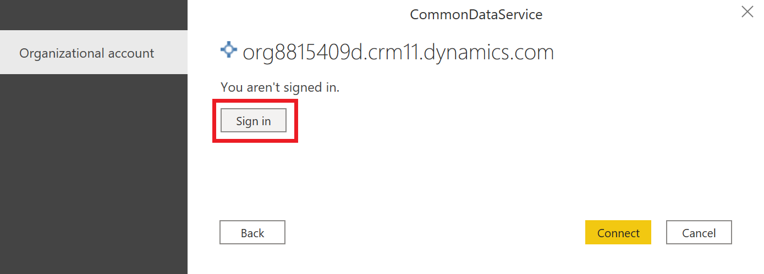
Connect to the environment
The environment’s tables are listed in Navigator dialog.
Microsoft Confidential
Notes:
Start working in Power BI Desktop
7. Open Power BI
8. Get Data
9. Choose CDS beta
10. Use the url from above.
11. Sign in within Power BI using demo credential
12. Identify the tables you require
12. Close and Load
13. Expand it to view the tables available to analyze. Select a table to view its data.

Slide 16
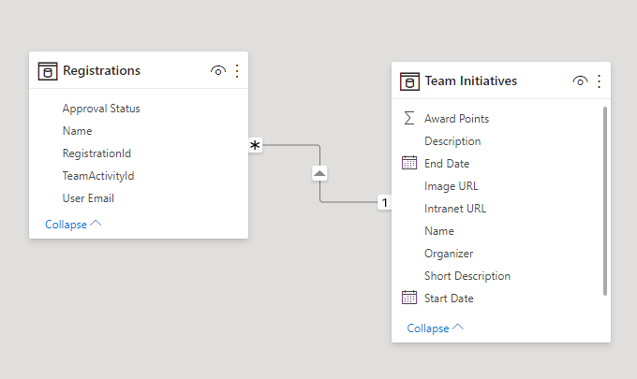
Model data in Power BI Desktop
Establish the relationships between tables and Start building visuals
Categorize and format data
Define calculations
Define Row-Level Security roles
Microsoft Confidential

Slide 17
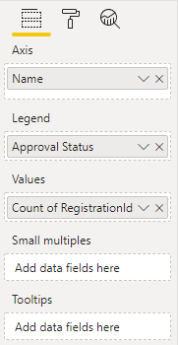
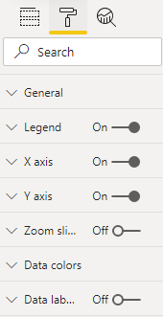
Visual properties and format
Visualizations (known as visuals for short) query the data model and display data in preferred way
Connect visual to the data and define how it should look like
Enable interactions between visuals
Many visuals are available out-of-box
Connect to data
Format look and feel
Microsoft Confidential
Notes:
R-based and Custom visuals can be used

Slide 18
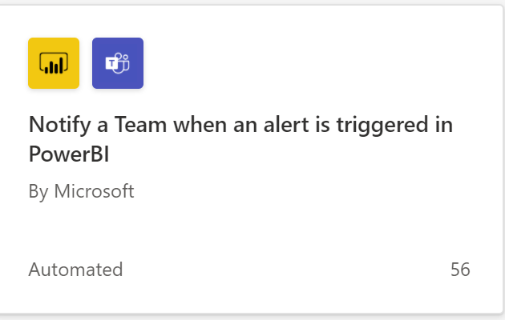
Power BI and Power Automate
Use built-in flow templates to notify a channel in Microsoft Teams when a data alert is triggered in Power BI report
Alerts can be triggered by Card and KPI visuals
Microsoft Confidential
Notes:
KPI - key performance indicator

Slide 19
Questions?

